Slide 1
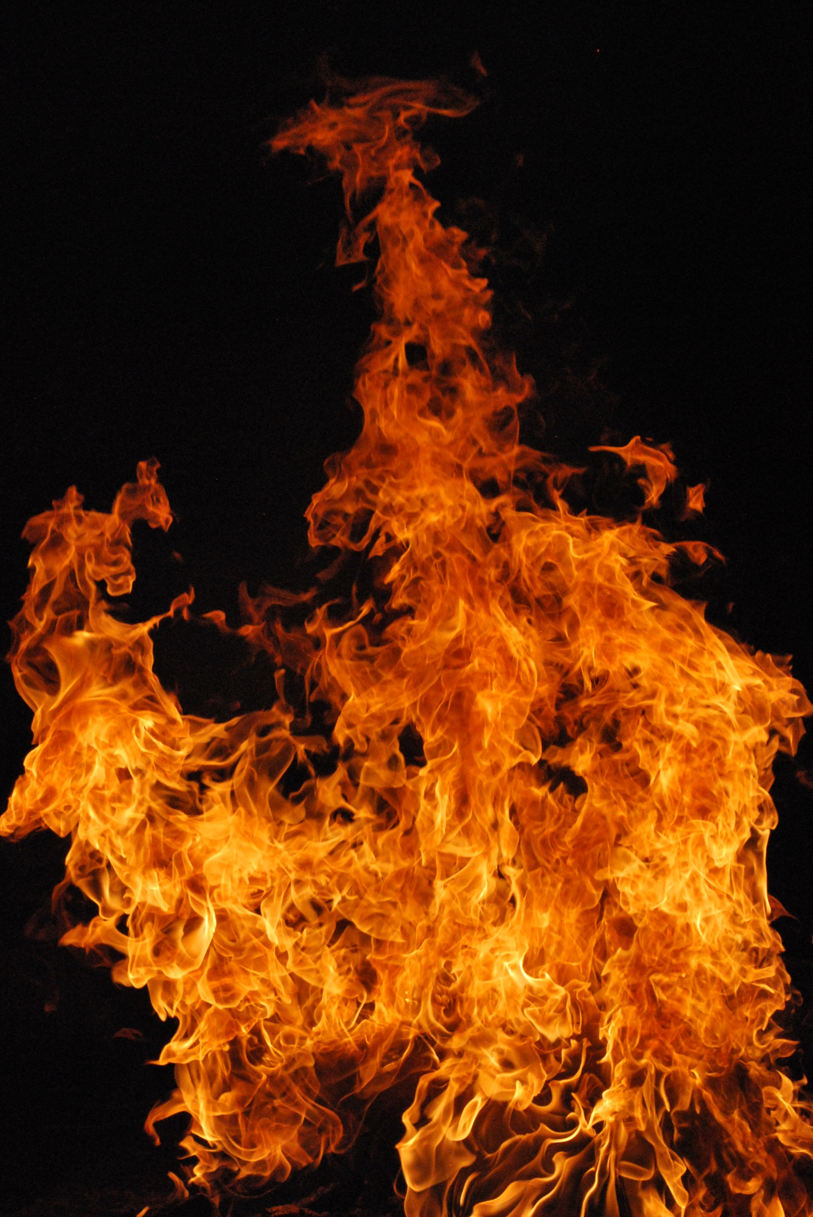
CALIFORNIA WILDFIRE DAMAGE
This Photo by Unknown Author is licensed under CC BY-SA
PRESENTED BY JANEFRANCES
NGANJIOZOR

Slide 2
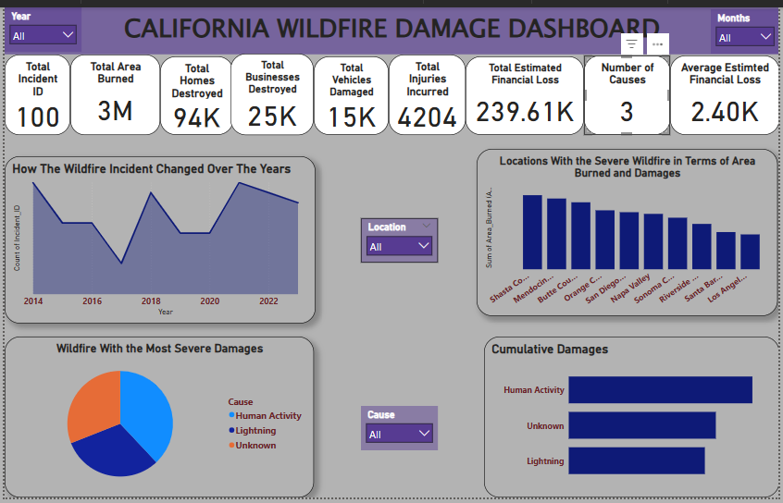
GENERAL OVERVIEW OF CALIFORNIA WILDFIRE DAMAGE

Slide 3
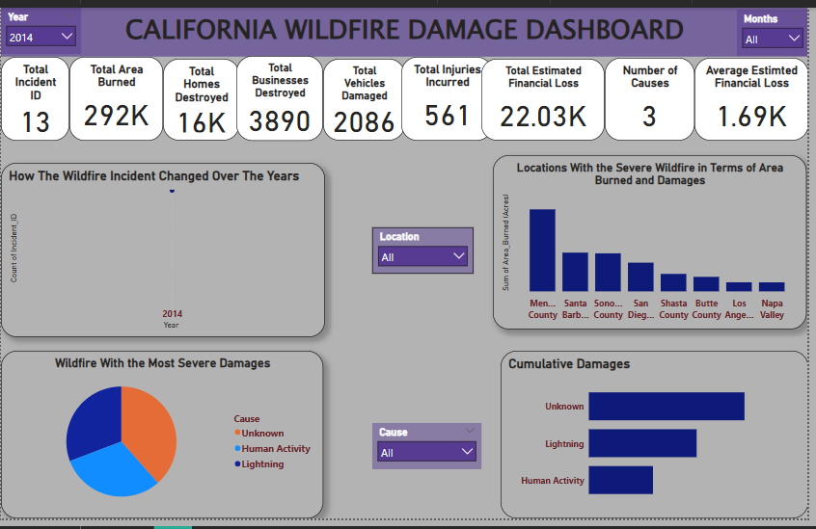
2014 CALIFORNIA WILDFIRE DAMAGE REPORT
OBSERVATIONS
California’s 2014 wildfire incident was caused by unknown factors which resulted in substantial loss of lives and properties damage. Mendocino country however, incurred the highest losses that year.

Slide 4
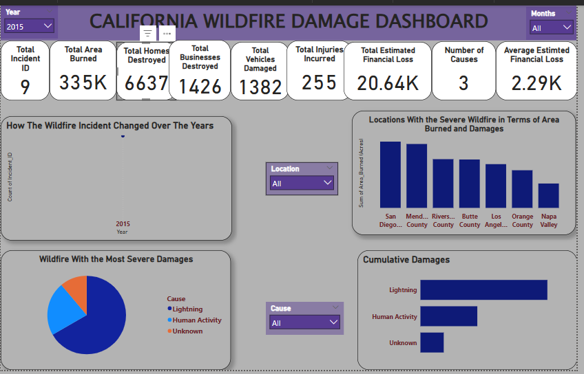
2015 CALIFORNIA WILDFIRE DAMAGE REPORT
OBSERVATIONS
Observations revealed that the 2015 California wildfire was triggered by a natural cause: lightning. Notably, Napa Valley was among the least affected areas.

Slide 5
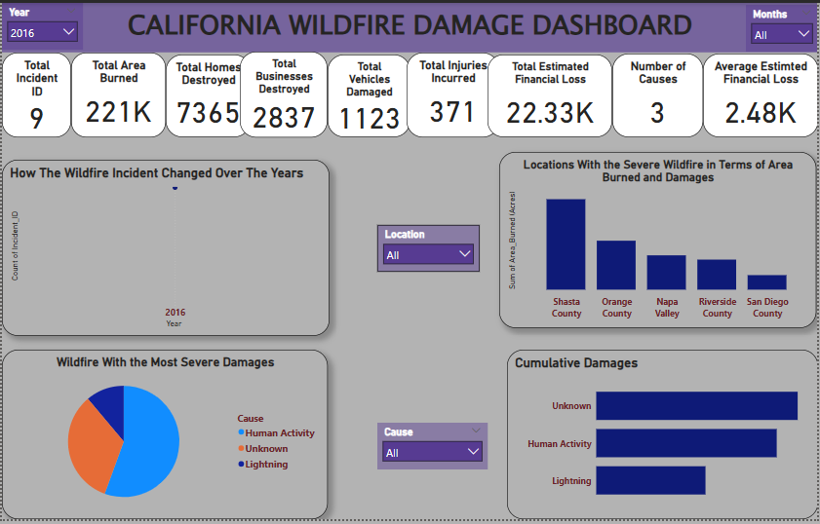
2016 CALIFORNIA WILDFIRE DAMAGE REPORT
OBSERVATIONS
Human activity was a significant contributing factor to the 2016 California wildfire, leading to devastating consequences including the loss of lives and properties. Shasta country was among the areas mostly severely impacted
.

Slide 6
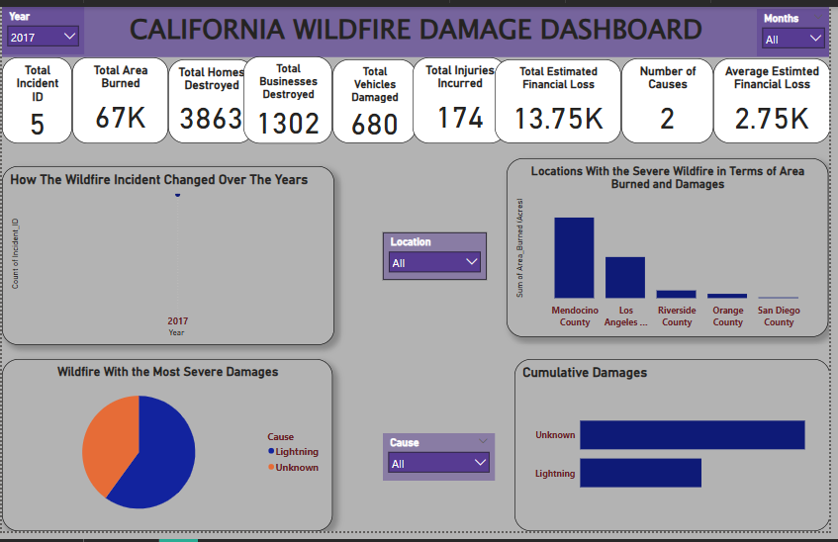
2017 CALIFORNIA WILDFIRE DAMAGE REPORT
OBSERVATIONS
Mendocino country suffered severe wildfire in terms of area burned damaged. The primary cause for the 2017 California wildfire was unknown.

Slide 7
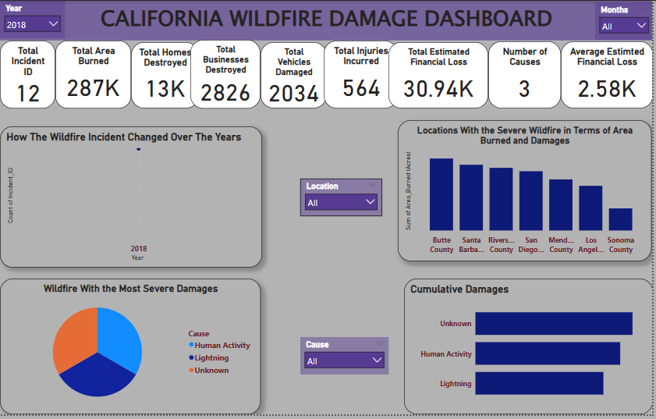
2018 CALIFORNIA WILDFIRE DAMAGE REPORT
OBSERVATIONS
Observations revealed that the 2018 California wildfire was triggered by a unknown cause. Notably, Sonoma country was among the least affected areas.

Slide 8
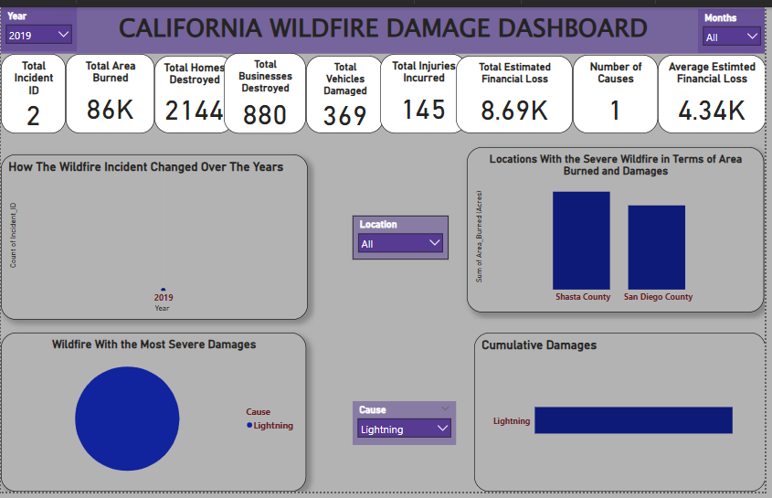
2019 CALIFONIA WILDFIRE DAMAGE REPORT
OBSERVATIONS
In 2019, lightning was identified as a cause of wildfires in California, with affected areas including Shasta country and San Diego country.

Slide 9
FINDINGS ON THE CALIFORNIA WILDFIRE FROM 2014-2019
Climate change and wildfire; California’s average temperature increased by 2.5 degrees Fahrenheit or 1.4 degrees Celsius between 2014 and 2018 contributing to increased wildfire risk.
Prolonged droughts and dry spells created conditions ripe for wildfires, with 2014 being the driest years on record.
Wildfire trends and impact; The number of wildfires in California increased by 40% between 2014 and 2019, with 2018 camp fire being the deadliest and most destructive wildfire in state history.
Property damage and loss; The 2017 Tubbs fire in Sonoma country destroyed over 5,600 structures, with estimated damages exceeding $10 billion.

